Slide 1
Joins in SQL
SQL Day 4 class

Slide 2
Learning Objectives
By the end of this lesson, you will be able to:
Identify the types of joins
Distinguish between INNER and OUTER joins
Apply the concepts learned in the lesson

Slide 3
JOINs Combine Related Data
JOINs allow you to combine data from multiple related tables into a single result set
Match rows between tables based on relate columns like IDs
Fundamental SQL concept for working with multiple tables
Basis for many complex queries, reports, and analyses

Slide 4
JOINs Combine Related Data
JOIN Statement
SELECT columns - Fields to include in output
FROM Table1 - First table referenced in join
JOIN Table2 - Second table referenced
ON condition - Column logic that matches rows

Slide 5
JOINs Combine Related Data
Example:
SELECT *
FROM Table1
INNER JOIN Table2
ON Table1.id = Table2.table1_id;

Slide 6
JOINs Combine Related Data
Main types of SQL JOINS:
INNER JOIN:
Returns only matching rows from both tables based on the join condition.
Excludes rows from either table that don't satisfy the ON clause.
LEFT OUTER JOIN:
Returns all rows from the left table even if no matching rows in right table.
Right table columns are NULL if no match found.

Slide 7
JOINs Combine Related Data
Main types of SQL JOINS:
RIGHT OUTER JOIN:
Returns all rows from the right table even if no matching rows in left table.
Left table columns are NULL if no match found.
Reverse of left join, keeping all rows from "right" table.
FULL OUTER JOIN:
Returns rows from both tables, left and right sides.
Good for combining tables and seeing all data including non-matches.
Unmatched rows will have NULL values for the other table's columns.

Slide 8
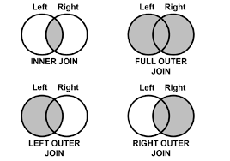
JOINs Combine Related Data

Slide 9
Join Conditions Related to Table Data
Defining Table Relationships
The ON clause specifies how two tables are related
It matches rows between tables based on column values
This connects related data across tables
Key Things to Know:
Essential component of table joining
Basis for linking and analyzing related table data
Filters query results based on defined relationships
Typically compare key columns like ID fields

Slide 10
Join Conditions Related to Table Data
Typical Join Condition:
ON Customers.CustomerID = Orders.CustomerID
Relating Table Data via Keys:
Common for standardized relationships
Links core table entities like customers to transactions
Why Match on Keys?
AdventureWorks2012
Each product has an ID in the Product table
Orders link to a product by storing their ID
Comparing IDs relates products to their details
.

Slide 11
Why Use Join Alias
Join aliases are useful for assigning table aliases in JOIN statements
Improves readability
Simplifies coding
You only need to type short aliases
Column name can be the same across tables
The syntax for a SQL JOIN with aliases is:
SELECT column_list
FROM table1 alias1
JOIN table2 alias2
ON alias1.join_column = alias2.join_column

Slide 12
Why Use Join Alias
Without aliases:
SELECT customers.name, orders.amount
FROM customers
JOIN orders
ON customers.id = orders.customer_id;
With aliases:
SELECT cust.name, ord.amount
FROM customers cust
JOIN orders ord
ON cust.id = ord.customer_id;

Slide 13
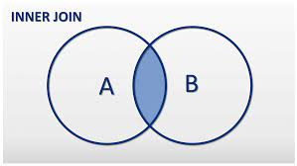
Inner Join Fundamentals

Slide 14
Inner Join Fundamentals
Inner Join Concepts
Ideal for assembling connected data
Result only includes related data
No duplication or missing values
Great for combining data about the same entities
INNER JOIN Example:
SELECT *
FROM TableA
JOIN TableB
ON TableA.id = TableB.tablea_id;

Slide 15
Inner Join Fundamentals
The key differences between JOIN and INNER JOIN:
JOIN by itself implicitly means INNER JOIN
They function the same way - matching rows where the ON condition is true
JOIN and INNER JOIN produce the same result set joining on a condition.
The INNER JOIN syntax just makes it clearer that you are intending an inner join rather than a different join type.

Slide 16
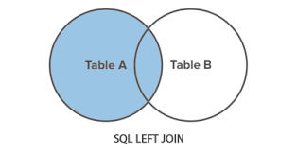
Left Join Fundamentals

Slide 17
Left Join Fundamentals
LEFT JOIN Example:
SELECT *
FROM Customers c
LEFT JOIN Orders o
ON c.id = o.cust_id
Key Points
Returns all rows from Left table
Matches right side rows if join condition met
Right columns are NULL if no match

Slide 18
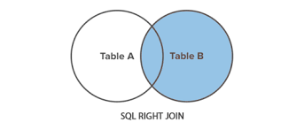
Right Join Fundamentals

Slide 19
Right Join Fundamentals
RIGHT JOIN Example:
SELECT *
FROM Orders o
RIGHT JOIN Customers c
ON o.cust_id = c.id;
RIGHT OUTER JOIN Fundamentals
Returns all rows from the right table
Left table rows included if join condition met
Left columns are NULL if no match

Slide 20
Right Join Fundamentals
RIGHT VS LEFT JOIN
LEFT JOIN is used 95% of the time
Reasons to use RIGHT JOIN
Sometimes you can be too lazy to reorder an ad hoc query
Confuse other people
Inherit existing code from others

Slide 21
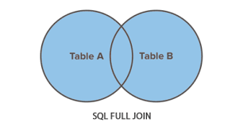
Full Outer Join Fundamentals

Slide 22
Full Outer Join Fundamentals
FULL OUTER JOINs Complete Data
Matching and Unmatched Rows from Both Tables
Returns all rows from the left and right tables
If no match, columns are NULL for missing side
FULL OUTER JOIN Example:
SELECT *
FROM TableA a
FULL JOIN TableB b
ON a.id = b.a_id

Slide 23
Joins Enabled Aggregated Analysis
Blending Joins and Aggregates
Joining multiple tables FIRST in a SQL query, and then aggregating the resulted joined data using functions like SUM, COUNT, AVG, etc.
For example:
Join a customers table to an orders table
Then, aggregate the joined data to summarize rather than seeing individual rows
This allows you to lend row level and summary data together

Slide 24
Joins Enabled Aggregated Analysis
SQL Syntax Pattern
SELECT customers.name, SUM(orders.amount) AS total_purchased
FROM customers
INNER JOIN orders
ON customers.id = orders.customer_id
GROUP BY customers.name

Slide 25
Joins Enabled Aggregated Analysis
Join a customers table to an orders table
SELECT c.name, o.amount
FROM customers c
JOIN orders o
ON c.id = o.customer_id
Then, aggregate the joined data
SELECT c.name, SUM(o.amount)
FROM customers c
JOIN orders o
ON c.id = o.customer_id
GROUP BY c.name

Slide 26
Joins Enabled Aggregated Analysis
Examples Using AdventerWorks2012:
Average reseller sales amount per year:
SELECT YEAR(sh.OrderDate) AS OrderYear, AVG(sd.LineTotal) AS AverageSales
FROM Sales.SalesOrderHeader sh
INNER JOIN Sales.SalesOrderDetail sd
ON sh.SalesOrderID = sd.SalesOrderID
GROUP BY YEAR(sh.OrderDate)

Slide 27
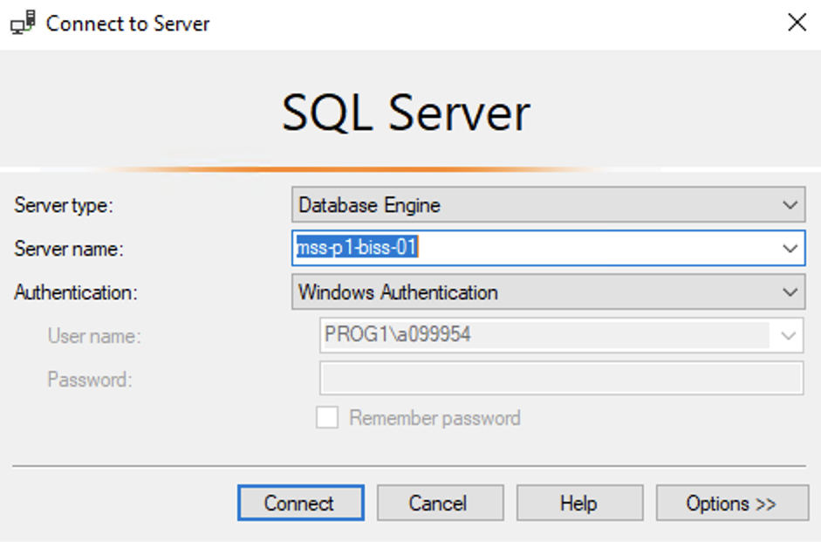
Hands On Examples
Using the AdventureWorks2012 Database
Please open up SSMS
Connect to BISS
Server = mss-p1-biss-01

Slide 28
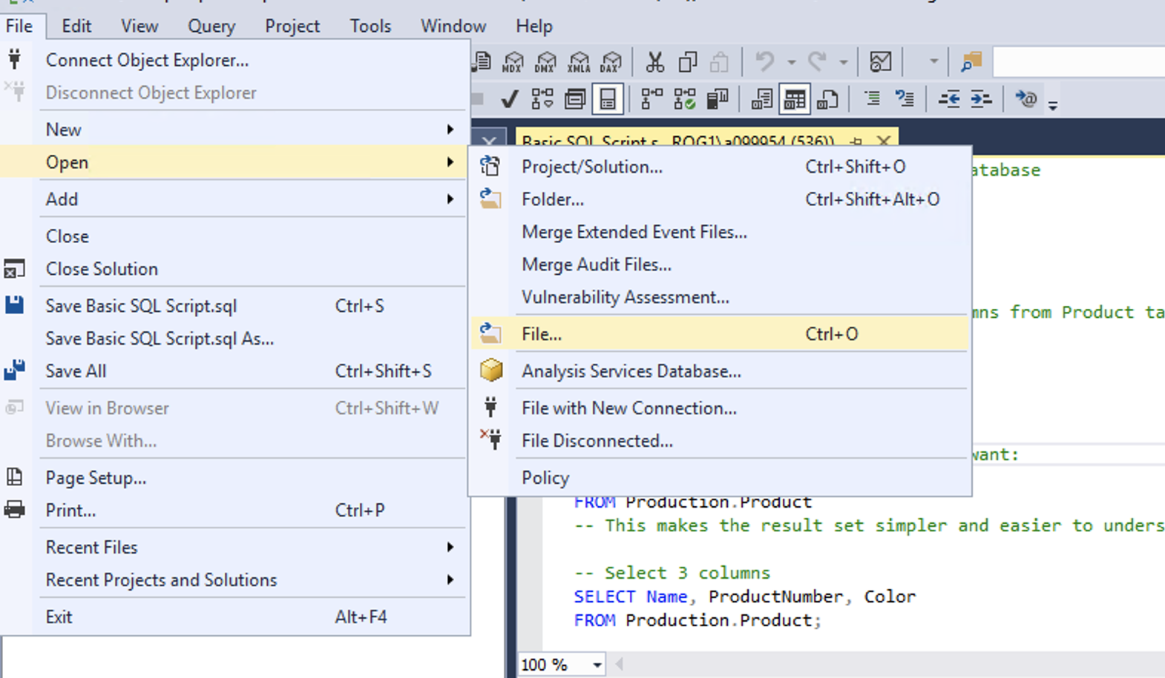
Hands On Examples
Click File -> Open -> File

Slide 29
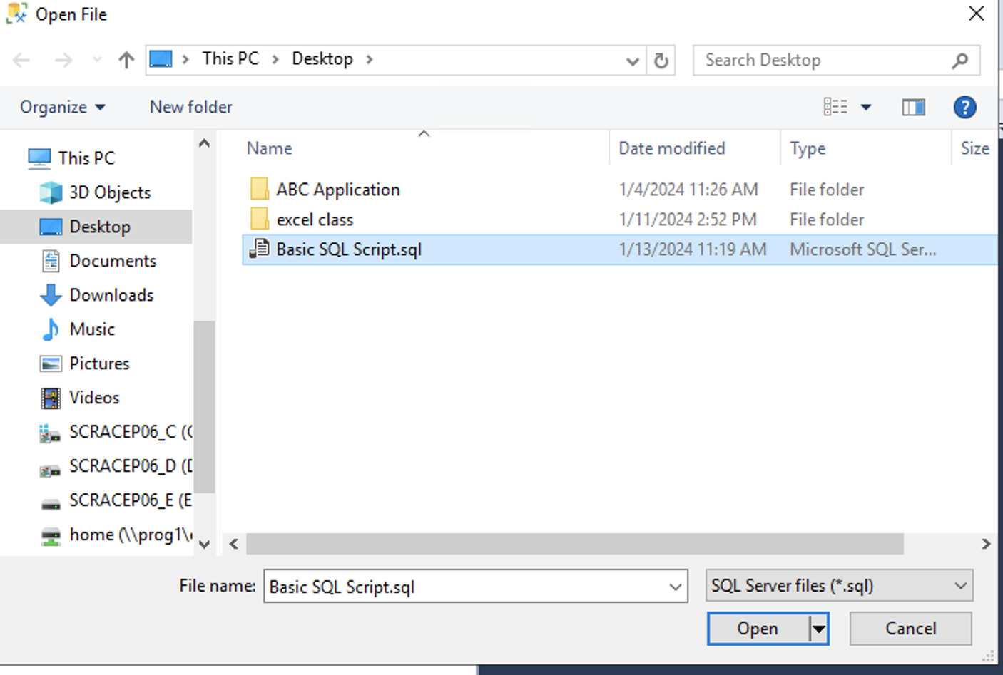
Hands On Examples
Open the SQL Day 4 Joins Script.sql file
Notes:
Walk through each function

Slide 30
Summary
Best Practices:
Use aliases for easier coding
Use LEFT JOIN every time
Aggregate and filter joined data
Optimize join order and performance
Purpose:
Joins deliver a foundation for many analytical tasks by interrelating data distributed across tables.
Careful construction and validation enables deriving maximum value

Slide 31
Exercise
Open the Day 4 Exercise.sql file
Answer the questions from each section
Notes:
Answers are stored in the Exercise Answers.sql file

